Slide 1
Reporting requests & commands (Indirektan govor – molbe i naredbe)

Slide 2
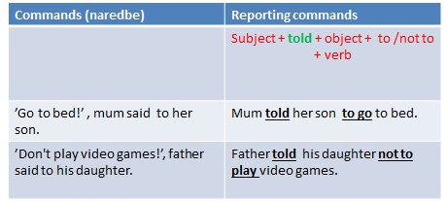
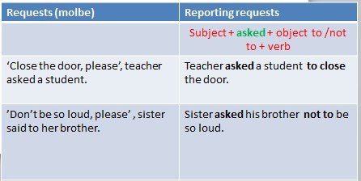

Slide 3
Reporting advice (Indirektan govor – saveti)
Advice | Reporting advice
 | Subject + advised + object + to/not to + verb
’I think you shoud put on your coat, ’ I said to him. | I advised him to put on his coat.
’You should see a doctor, ’ I said to her. | I advised her to see a doctor.
’ You should stop smoking, ’ the doctor said to my father. | The doctor advised my father not to smoke.
’You shouldn’t go out, ’ the doctor said to her. | The doctor advised her not to go out.

Slide 4
Let’s practise
Report these commands, requests and advice:
1) ’Let’s watch a film ’ a daughter said to her mum.
2) ’Turn on the lights, please, ’ a teacher said to the children.
3) ’Don't buy any eggs, please , ’ a neighbour said to a friend.
4) ’Please, don't talk any more, ’ a friend said to him.
5) ’Do your homework, ’ a parent said to a child.
6) ’Stop the car, ’ a policeman said to a man.
7) ’Don't smoke near the petrol pump, ’ a worker said to a man.
8) ’Don’t go out, ’ a parent said to a child.
9) ’Drink a lot of water,’ a doctor said to a patient.
10) ’You shouldn’t wash this T-shirt with that laundry,’ mum said to her daughter.

Slide 5
Rešenja:
A daughter asked her mum to watch a film.
A teacher asked the children to turn on the lights.
A neighbour advised his friend not to buy any eggs.
A friend asked him not to talk any more.
A parent told a child to do his homework.
A policeman told a man to stop the car.
A worker told a man not to smoke near the petrol pump.
A parent told a child not to go out.
A doctor advised a patient to drink a lot of water.
Mum advised her daughter not to wash that T-shirt with that laundry.

Slide 6
Homework: Report these commands, requests and advice
“I think you should make the reservations early.” (She advised me)
“You might want to bring some extra money for food.” (Tom advised them)
“It might be a good idea to see a doctor.” (Mrs Atkins advised her friend)
“You should probably take some warm clothes.” (They advised us)
“I’d stick together so that you don’t get lost.” (He advised her)
“It might be a good idea to buy a map.” (The guide advised the tourists)
“If I were in your shoes, I would leave early.” (John advised his son)
“I think you should check the weather forecast.” (The teacher advised her students)

